Slide 1


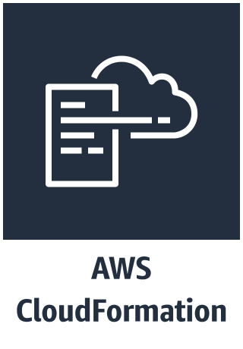
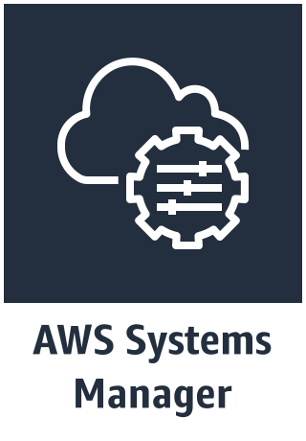


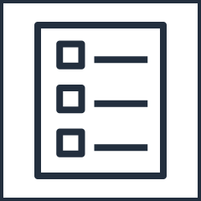
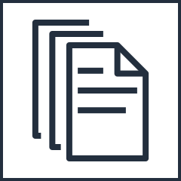
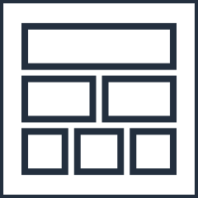

AWS Cloud
Region
On both nodes
On DC1
1. Gets instance IDs for both nodes
3. Configures LCM
5. Generates MOF file on DC1
AD Quick Start template
AWSQuickstartActiveDirectoryDS
4. Gets instance ID for DC1
6. Loops through DSC configuration on DC1
2. Two steps: - installs DSC modules needed for Quick Start
- configures certificate for credential encryption
AD Quick Start stack
DC2 starts Automation document
Start Automation
DC2
Signals success back to AD stack
On DC2
AWS CFNSignalEnd success or sleep
If signal
7. Gets instance ID for DC2
9. Loops through DSC configuration on DC2
12. Signals AWS CloudFormation success
11. Branch
determines if AWS CloudFormation needs to be signaled or to end
End
If any step fails, CFN Signal Failure attempts to signal CFN of the failure
8. Generates MOF file on DC2
10. Configures DNS on each DC to point to AD DNS
If no signal, then end
12. Sleeps 1 second

Slide 2


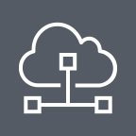

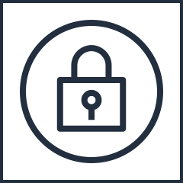

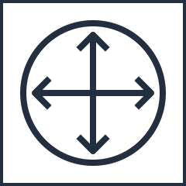
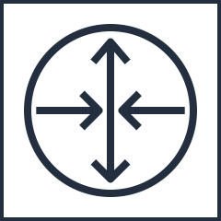
AWS Cloud
VPC
Availability Zone 1
Availability Zone 2
VPC subnet
VPC subnet
On premises
Customer
network
VPN
gateway
VPN connection
Customer gateway
Router

Slide 3
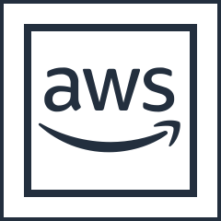
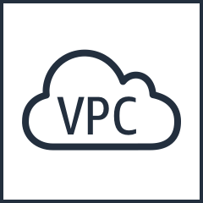
AWS local region
AWS Direct Connect location
AWS cage
AWS Direct Connect router
Customer or
partner cage
Customer or partner router
Customer router or firewall
Private virtual interface
Public virtual interface
Customer DMZ
Customer Network

Slide 4
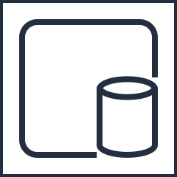

AWS Cloud
VPC
Active Directory site (named after region)
Availability Zone 1
Availability Zone 2
Private subnet
10.0.0.0/19
Private subnet
10.0.32.0/19
On-Premise
Customer
Network
DC\GC\DNS
DC\GC\DNS
VPN
gateway
VPN connection
Customer gateway
Domain controller 1
(DC1)
Domain controller 2
(DC2)
DC\GC\DNS
(DC)
Active Directory 192.168.1.0/24
Active Directory replication

Slide 5

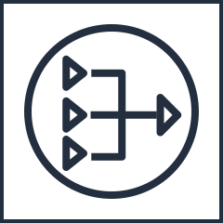
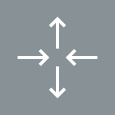
This was the original scenario 1. See separate updated .pptx file.
Remote management and administration
AWS Cloud
VPC 10.0.0.0/16
Active Directory site (named after region)
Availability Zone 1
Availability Zone 2
Public subnet
10.0.128.0/20
Public subnet
10.0.144.0/20
Auto Scaling group
NAT gateway
RDGW
RDGW
NAT gateway
Private subnet
10.0.0.0/19
Private subnet
10.0.32.0/19
DC\GC\DNS
DC\GC\DNS
Domain controller 1
(DC1)
Domain controller 2
(DC2)

Slide 6
This was the original scenario 2. See separate updated .pptx file.
Remote management and administration
AWS Cloud
VPC 10.0.0.0/16
Active Directory site (named after region)
Availability Zone 1
Availability Zone 2
Public subnet
10.0.128.0/20
Public subnet
10.0.144.0/20
Auto Scaling group
NAT gateway
On premises
RDGW
RDGW
NAT gateway
Private subnet
10.0.0.0/19
Private subnet
10.0.32.0/19
VPN
gateway
VPN connection
Customer gateway
DC\GC\DNS
(DC)
DC\GC\DNS
DC\GC\DNS
Active Directory 192.168.1.0/24
Active Directory replication
Domain controller 1
(DC1)
Domain controller 2
(DC2)

Slide 7
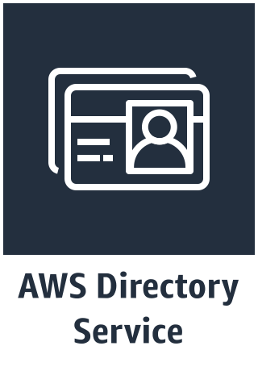
This was the original scenario 3. See separate updated .pptx file.
Remote management and administration
AWS Cloud
VPC 10.0.0.0/16
Availability Zone 1
Availability Zone 2
Public subnet
10.0.128.0/20
Public subnet
10.0.144.0/20
Auto Scaling group
NAT gateway
RDGW
RDGW
NAT gateway
Private subnet
10.0.0.0/19
Private subnet
10.0.32.0/19
for Microsoft AD
for Microsoft AD

